Slide 1
Information Security

Slide 2
Diffie-Hellman Key Exchange
First public-key type scheme proposed
by Diffie & Hellman in 1976 along with the exposition of public key concepts
  note: now know that Williamson (UK CESG) secretly proposed the concept in 1970
It is a practical method for public exchange of a secret key used in a number of commercial products
Notes:
This chapter continues our overview of public-key cryptography systems (PKCSs), and begins with a description of one of the earliest and simplest PKCS, Diffie-Hellman key exchange. This first published public-key algorithm appeared in the seminal paper by Diffie and Hellman that defined public-key cryptography [DIFF76b] and is generally referred to as Diffie-Hellman key exchange. The concept had been previously described in a classified report in 1970 by Williamson (UK CESG) - and subsequently declassified in 1987, see [ELLI99]. The purpose of the algorithm is to enable two users to securely exchange a key that can then be used for subsequent encryption of messages. The algorithm itself is limited to the exchange of secret values. A number of commercial products employ this key exchange technique.

Slide 3
Diffie-Hellman Key Exchange
A public-key distribution scheme
  cannot be used to exchange an arbitrary message
  rather it can establish a common key
  known only to the two participants
Value of key depends on the participants (and their private and public key information)
Based on exponentiation in a finite (Galois) field (modulo a prime or a polynomial) - easy
Security relies on the difficulty of computing discrete logarithms (similar to factoring) – hard
Notes:
The purpose of the algorithm is to enable two users to securely exchange a key that can then be used for subsequent encryption of messages. The algorithm itself is limited to the exchange of secret values, which depends on the value of the public/private keys of the participants. The Diffie-Hellman algorithm uses exponentiation in a finite (Galois) field (modulo a prime or a polynomial), and depends for its effectiveness on the difficulty of computing discrete logarithms.

Slide 4
Diffie-Hellman Setup
All users agree on global parameters:
  large prime integer or polynomial q
  a being a primitive root mod q
Each user (eg. A) generates their key
  chooses a secret key (number): x_{A} < q
  compute their public key: y_{A} = a^{xA} mod q
Each user makes public that key y_{A}
Notes:
In the Diffie-Hellman key exchange algorithm, there are two publicly known numbers: a prime number q and an integer a that is a primitive root of q. The prime q and primitive root a can be common to all using some instance of the D-H scheme. Note that the primitive root a is a number whose powers successively generate all the elements mod q. Users Alice and Bob choose random secrets x's, and then "protect" them using exponentiation to create their public y's. For an attacker monitoring the exchange of the y's to recover either of the x's, they'd need to solve the discrete logarithm problem, which is hard.

Slide 5
Diffie-Hellman Key Exchange
shared session key for users A & B is K_{AB}:
  K_{B}= y_{A}^{xB} mod q (which B can compute)
  K_{A}= y_{B}^{xA} mod q (which A can compute)
K_{AB} is used as session key in private-key encryption scheme between Alice and Bob
if Alice and Bob subsequently communicate, they will have the same key as before, unless they choose new public-keys
attacker needs an x, must solve discrete log
Notes:
The actual key exchange for either party consists of raising the others "public key' to power of their private key. The resulting number (or as much of as is necessary) is used as the key for a block cipher or other private key scheme. For an attacker to obtain the same value they need at least one of the secret numbers, which means solving a discrete log, which is computationally infeasible given large enough numbers. Note that if Alice and Bob subsequently communicate, they will have the same key as before, unless they choose new public-keys.

Slide 6
Description of the algorithm
Suppose Alice and Bob want to agree upon a key to be used for encryption / decryption message that would be exchanged between them. Then diffie-hellman key exchange works as follows:
1. Alice & bob agree on two large prime numbers: q and α
(note: these two integer need not be kept secret, insecure channel)
2. Alice choose another large random number Xa and calculate Ya​ such
that,
3. Alice send the number Xa to Bob.
4. Bob independently choose another large random integer Xb and
calculate Yb such that,
5. Bob send the number B to Alice.
6. Alice, now compute the secret key K1 as follows:
Ya ​ = α^{xa} mod q
Yb = α^{Xb} mod q
K1 = Yb ^{xa} mod q

Slide 7
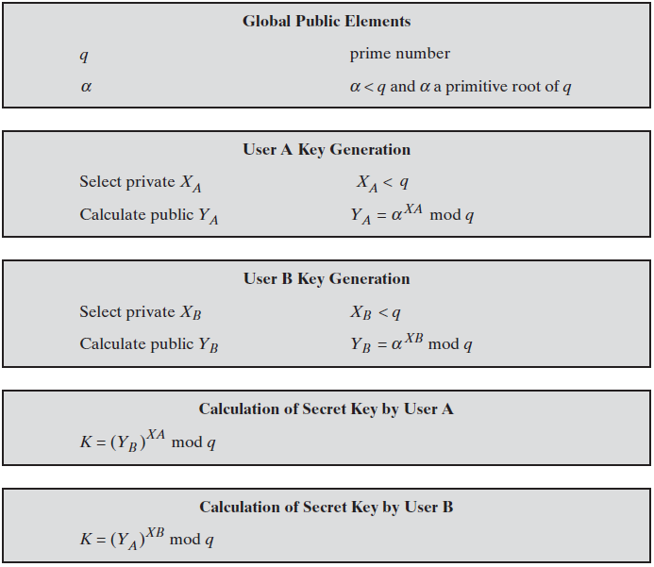
Diffie-Hellman Key Exchange

Slide 8
Diffie-Hellman Key Exchange
It is a protocol that enables two users to establish a secret key using a public-key scheme based on discrete logarithms.
Primitive Root:
A primitive root of a prime number p as one whose powers modulo generate all the integers from 1 to p-1. That is, if a is a primitive root of the prime number p, then the numbers
are distinct and consist of the integers from 1 through p - 1 in some permutation.
For any integer b and a primitive root a of prime number p, we can find a unique exponent i such that
The exponent i is referred to as the discrete logarithm of b for the base a, mod p.
Notes:
Diffie-Hellman Key Exchange Algorithm:
For this scheme, there are two publicly known numbers: a prime number q and an integer α that is a primitive root of q. Suppose the users A and B wish to exchange a key K. User A selects a random integer X_{A} < q and computes Y_{A}. Similarly, user B independently selects a random integer X_{B} < q and computes Y_{B}. Each side keeps the X value private and makes the Y value available publicly to the other side. The whole algorithm can be summarized as follows:

Slide 9
Example of the Diffie -Hellman algorithm
Large Prime Number
Alice
q=11, α =2
Bob
Large Random
Number
Xa=8
Xb=4
Large Random
Number
Ya = 2⁸ mod 11
= 5
Yb = 2⁴ mod 11
= 3
Ya = 5
Yb = 3
K1 = 3⁸ mod 11
= 4
K2 = 5⁴ mod 11
= 4
K1 = K2 = K
Note: A,B,K1,K2 are Private to others

Slide 10
Example of the Diffie -Hellman algorithm
7. Bob, now compute the secret key K2 as follows:
8. Surprise, K1=K2=K (which is symmetric key)
K2 = Ya^{Xb} mod n

Slide 11
Key Exchange Protocols
Users could create random private/public D-H keys each time they communicate
Users could create a known private/public D-H key and publish in a directory, then consulted and used to securely communicate with them
Both of these are vulnerable to a Man-in-the-Middle Attack
Authentication of the keys is needed
Notes:
Now consider a simple protocol that makes use of the Diffie-Hellman calculation. Suppose that user A wishes to set up a connection with user B and use a secret key to encrypt messages on that connection. User A can generate a one-time private key X_{A}, calculate Y_{A}, and send that to user B. User B responds by generating a private value X_{B}, calculating Y_{B}, and sending Y_{B} to user A. Both users can now calculate the key. The necessary public values q and a would need to be known ahead of time. Alternatively, user A could pick values for q and a and include those in the first message.

Slide 12
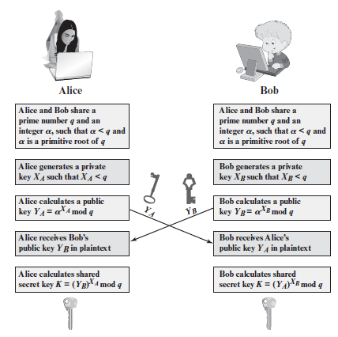
Key Exchange Protocols
Notes:
Now consider a simple protocol that makes use of the Diffie-Hellman calculation. Suppose that user A wishes to set up a connection with user B and use a secret key to encrypt messages on that connection. User A can generate a one-time private key X_{A}, calculate Y_{A}, and send that to user B. User B responds by generating a private value X_{B}, calculating Y_{B}, and sending Y_{B} to user A. Both users can now calculate the key. The necessary public values q and a would need to be known ahead of time. Alternatively, user A could pick values for q and a and include those in the first message.

Slide 13
Man-in-the-Middle Attack
Darth prepares by creating two private / public keys
Alice transmits her public key to Bob
Darth intercepts this and transmits his first public key to Bob. Darth also calculates a shared key with Alice
Bob receives the public key and calculates the shared key (with Darth instead of Alice)
Bob transmits his public key to Alice
Darth intercepts this and transmits his second public key to Alice. Darth calculates a shared key with Bob
Alice receives the key and calculates the shared key (with Darth instead of Bob)
Darth can then intercept, decrypt, re-encrypt, forward all messages between Alice & Bob
Notes:
The protocol described on the previous slide is insecure against a man-in-the-middle attack. Suppose Alice and Bob wish to exchange keys, and Darth is the adversary. The attack proceeds as follows:
Darth prepares for the attack by generating two random private keys X_{D1} and X_{D2} and then computing the corresponding public keys Y_{D1} and Y_{D2}
Alice transmits Y_{A} to Bob.
Darth intercepts Y_{A} and transmits Y_{D1} to Bob. Darth also calculates K2 = (Y_{A} )^ X_{D2} mod q
Bob receives Y_{D1} and calculates K1=(Y_{D1} )^ X_{B} mod q
Bob transmits Y_{B} to Alice.
Darth intercepts Y_{B} and transmits Y_{D2} to Alice. Darth calculates K1=(Y_{B} )^ X_{D1} mod q
Alice receives Y_{D2} and calculates K2=(Y_{D2} )^ X_{A} mod q .
At this point, Bob and Alice think that they share a secret key, but instead Bob and Darth share secret key K1 and Alice and Darth share secret key K2. All future communication between Bob and Alice is compromised in the following way:
Alice sends an encrypted message M: E(K2, M).
Darth intercepts the encrypted message and decrypts it, to recover M.
Darth sends Bob E(K1, M) or E(K1, M'), where M' is any message. In the first case, Darth simply wants to eavesdrop on the communication without altering it. In the second case, Darth wants to modify the message going to Bob. The key exchange protocol is vulnerable to such an attack because it does not authenticate the participants. This vulnerability can be overcome with the use of digital signatures and public- key certificates.

Slide 14
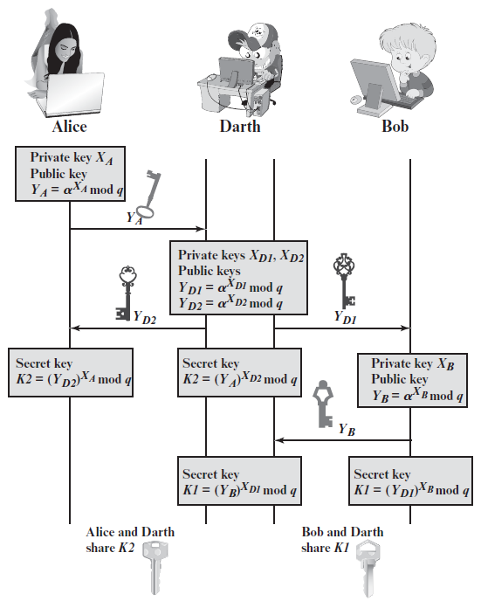
Man-in-the-Middle Attack
Notes:
The protocol described on the previous slide is insecure against a man-in-the-middle attack. Suppose Alice and Bob wish to exchange keys, and Darth is the adversary. The attack proceeds as follows:
Darth prepares for the attack by generating two random private keys X_{D1} and X_{D2} and then computing the corresponding public keys Y_{D1} and Y_{D2}
Alice transmits Y_{A} to Bob.
Darth intercepts Y_{A} and transmits Y_{D1} to Bob. Darth also calculates K2 = (Y_{A} )^ X_{D2} mod q
Bob receives Y_{D1} and calculates K1=(Y_{D1} )^ X_{B} mod q
Bob transmits Y_{B} to Alice.
Darth intercepts Y_{B} and transmits Y_{D2} to Alice. Darth calculates K1=(Y_{B} )^ X_{D1} mod q
Alice receives Y_{D2} and calculates K2=(Y_{D2} )^ X_{A} mod q .
At this point, Bob and Alice think that they share a secret key, but instead Bob and Darth share secret key K1 and Alice and Darth share secret key K2. All future communication between Bob and Alice is compromised in the following way:
Alice sends an encrypted message M: E(K2, M).
Darth intercepts the encrypted message and decrypts it, to recover M.
Darth sends Bob E(K1, M) or E(K1, M'), where M' is any message. In the first case, Darth simply wants to eavesdrop on the communication without altering it. In the second case, Darth wants to modify the message going to Bob. The key exchange protocol is vulnerable to such an attack because it does not authenticate the participants. This vulnerability can be overcome with the use of digital signatures and public- key certificates.

Slide 15
Man-in-the-Middle Attack
Can diffie-hellman solve our problem associated with key exchange? Unfortunately, not quite!
This algorithm fall into “man in the middle attack”
This work as follows:
Step-1:
  Alice want to communicate to Bob so as usual they use diffie-hellman key exchange so Let q=11 & α =7. they find K1 and K2 .
Step-2:
  Alice does not realize that the attacker Darth is listening the conversation between her and Bob.
  TOM simply pick up the value of n and α. (q=11, α =7)
  Alice Darth Bob
Step-3:
  Now let us assume that Alice, Darth & Bob select random number Xa & Xb as bellow:
  Alice Darth Bob
q=11, α =7
n=11, α =7
n=11, α =7
Xa=3
Xa=8,Xb=6
Xb=9

Slide 16
Man-in-the-Middle Attack
Step-4:
  Now all these person calculate the value of Ya and Yb.
  Ya= α ^{Xa} mod n Ya= α ^{Xa} mod n Yb= α ^{Xb} mod n
  =7³ mod 11 =2 =7⁸ mod 11 = 9 =7⁹ mod 11 = 8
  Yb= α ^{Xb} mod n
  =7⁶ mod 11 = 4
Step-5:
Alice DARTH Bob
Ya=2
Darth intercept
The value of Ya
And send Bob his
Own value of Ya
Ya=9
Darth intercept
The value of Yb
And send Alice his
Own value of Yb
Yb=4
Yb=8

Slide 17
Man-in-the-Middle Attack
Step-6:
  So at last value of Ya,Yb to users are:
* indicate value of A and B changed.
Step-7:
  Based on these values, all the three person now calculate their Keys.
Ya=2,Yb=4*
Ya=2,Yb=8
Ya=9*,Yb=8
Alice
Darth
Bob
K1=Yb^{Xa} mod n
=4³ mod 11
=9
K1=Yb^{Xa} mod n
=8⁸ mod 11
=5
K2=Ya^{Xb} mod n
=2⁶ mod 11
=9
K2=Ya^{Xb} mod n
=9⁹ mod 11
=5
Solution: ?
( User authentication required )

Slide 18
Diffie-Hellman Key Exchange
The key exchange protocol is vulnerable to such an attack because it does not authenticate the participants. This vulnerability can be overcome with the use of digital signatures and public-key certificates.

Slide 19
Public Key Encryption Algorithms
Almost all public-key encryption algorithms use either number theory and modular arithmetic, or elliptic curves
RSA
  based on the hardness of factoring large numbers
El Gamal
  Based on the hardness of solving discrete logarithm
  Basic idea: public key g^{x}, private key x, to encrypt: [g^{y}, g^{xy} M].

Slide 20
ElGamal Cryptography
public-key cryptosystem related to D-H
uses exponentiation in a finite field
with security based difficulty of computing discrete logarithms, as in D-H
each user (eg. A) generates their key
  chooses a secret key (number): 1 < x_{A} < q-1
  compute their public key: y_{A} = a^{xA} mod q
Notes:
In 1984, T. Elgamal announced a public-key scheme based on discrete logarithms, closely related to the Diffie-Hellman technique [ELGA84, ELGA85]. The ElGamal cryptosystem is used in some form in a number of standards including the digital signature standard (DSS) and the S/MIME email standard. As with Diffie-Hellman, the global elements of ElGamal are a prime number q and a, which is a primitive root of q. User A generates a private/public key pair as shown. The security of ElGamal is based on the difficulty of computing discrete logarithms, to recover either x given y, or k given K (next slide).

Slide 21
ElGamal Message Exchange
Bob encrypts a message to send to A computing
  represent message M in range 0 <= M <= q-1
    longer messages must be sent as blocks
  chose random integer k with 1 <= k <= q-1
  compute one-time key K = y_{A}^{k} mod q
  Encryption: encrypt M as a pair of integers (C₁,C₂) where
    C₁ = a^{k} mod q ; C₂ = KM mod q
A then recovers message by
  recovering key K as K = C₁^{xA} mod q
  computing M as M = C₂ K⁻¹ mod q
a unique k must be used each time
  otherwise result is insecure
Notes:
Any user B that has access to A's public key can encrypt a message as shown. These steps correspond to Figure 9.1a in that Alice generates a public/private key pair; Bob encrypts using Alice's public key; and Alice decrypts using her private key. See text for details of why these steps result in M being recovered. Note that K functions as a one-time key, used to encrypt and decrypt the message. If a message must be broken up into blocks and sent as a sequence of encrypted blocks, a unique value of k should be used for each block. If k is used for more than one block, knowledge of one block m of the message enables the user to compute other blocks as shown in the text.
The basic idea with El Gamal encryption is to choose a random key, protect it, then use it to scramble the message by multiplying the message with it. Two bits of info have to be sent: the first to recover this temporary key, the second the actual scrambled message. See that El Gamal encryption involves 1 modulo exponentiation and a multiplication (vs 1 exponentiation for RSA).

Slide 22
ElGamal Example1
use field GF(19) q=19 and a=10 (primitive root of 19)
Alice computes her key:
  A chooses x_{A}=5 (private key) & computes y_{A}=10⁵ mod 19 = 3 (public key)
Encryption: Bob send message m=17 as (11,5) by
  choosing random k=6
  computing K = y_{A}^{k} mod q = 3⁶ mod 19 = 7
  computing C₁ = a^{k} mod q = 10⁶ mod 19 = 11;
  C₂ = KM mod q = 7.17 mod 19 = 5
Decryption: Alice recovers original message by computing:
  recover K = C₁^{xA} mod q = 11⁵ mod 19 = 7
  compute inverse K⁻¹ = 7⁻¹ = 11
  recover M = C₂ K⁻¹ mod q = 5.11 mod 19 = 17
Notes:
Here is an example of ElGamal from the text using the prime field GF(19); that is, q = 19. It has primitive roots {2, 3, 10, 13, 14, 15}, as shown in Table 8.3. We choose a = 10. Alice generates a key pair as shown. Suppose Bob wants to send the message with the value M = 17. Then he computes the ciphertext pair (11, 5) and sends this to Alice. Alice recovers the message by first recovering K, then computing its inverse (using the Extended Euclids Algorithm – see Ch 4), and finally recovering M.

Slide 23
RSA Algorithm
Invented in 1978 by Ron Rivest, Adi Shamir and Leonard Adleman
  Published as R L Rivest, A Shamir, L Adleman, "On Digital Signatures and Public Key Cryptosystems", Communications of the ACM, vol 21 no 2, pp120-126, Feb 1978
Security relies on the difficulty of factoring large composite numbers
Essentially the same algorithm was discovered in 1973 by Clifford Cocks, who works for the British intelligence.

Slide 24
RSA Algorithm
It is a public key cryptography algorithm, which was proposed by Diffie and Hellman. RSA can be used for key exchange, digital signatures and the encryption of small blocks of data.
RSA is primarily used to encrypt the session key used for secret key encryption (message integrity) or the message's hash value (digital signature).
RSA's mathematical hardness comes from the ease in calculating large numbers and the difficulty in finding the prime factors of those large numbers.

Slide 25
RSA Key
Key generation:
1. Select 2 large prime numbers of about the same size, p and q but p and q has not equal values.
  Typically each p, q has between 512 and 2048 bits
2. Compute n = pq, and Φ(n) = (q-1)(p-1)
3. Select e, s.t. gcd(e, Φ(n)) = 1
  Typically e=3 or e=65537
4. Compute d, s.t. ed ≡ 1 mod Φ(n)
  Knowing Φ(n), d easy to compute.
Public key: (e, n)
Private key: (d,n)

Slide 26
RSA: Choosing keys
1. Choose two large prime numbers p, q.
(e.g., 1024 bits each)
2. Compute n = pq, Φ = (p-1)(q-1)
3. Choose e (with e<n) that has no common factors
with Φ. (e, Φ are “relatively prime”).
4. Choose d such that ed-1 is exactly divisible by Φ.
(in other words: ed mod Φ = 1 ).
5. Public key is (n,e). Private key is (n,d).
+
K
-
B
K
B

Slide 27
RSA Algorithm
Encryption
Given a message M, 0 < M < n M ∈ Z_{n}− {0}
use public key (e, n)
compute C = Me mod n C ∈ Z_{n}− {0}
Decryption
Given a ciphertext C, use private key (d)
Compute C^{d} mod n = (Me mod n)^{d} mod n = M^{ed} mod n = M

Slide 28
RSA: Encryption, decryption
0. Given (n,e) and (n,d) as computed above
1. To encrypt bit pattern, m, compute
c = m^{e} mod n
e
(i.e., remainder when m is divided by n)
2. To decrypt received bit pattern, c, compute
m = c^{d} mod n
(i.e., remainder when c^{d} is divided by n)
d
m = (m^{e} mod n)
mod n
c

Slide 29
RSA Algorithm
C = Me mod (n=pq)
Plaintext: M
Ciphertext: C
C^{d} mod n
From n, difficult to figure out p,q
From (n,e), difficult to figure d.
From (n,e) and C, difficult to figure out M s.t. C = Me

Slide 30
RSA Example
P=5 & q=7(prime and p ≠q)
n=5*7=35 n=p*q and Φ(n)=(4)*(6) = 24 Φ= (p-1)(q-1)
e = 5 1<e< Φ(n), s.t. gcd(e, Φ(n)) = 1
d = 29 , (29x5 –1) is exactly divisible by 24
Keys generated are
  Public key: (35,5) (n,e)
  Private key is (35, 29) (n,d)
Encrypt the word lo using (c = m^{e} mod n)
  Assume that the alphabets are between 1 & 26
Plain Text | Numeric Representation | m^{e} | Cipher Text (c = m^{e} mod n)
l | 12 | 248832 | 17
o | 15 | 759375 | 15
Notes:
1. Must have done this as an assignment last year.

Slide 31
Decrypt the word love using (m = c^{d} mod n)
  n = 35, c=29
Cipher Text | c^{d} | (m = m^{e} mod n) | Plain Text
17 | 481968572106750915091411825223072000 | 17 | l
15 | 12783403948858939111232757568359400 | 15 | o
Notes:
1. Must have done this as an assignment last year.

Slide 32
RSA Example
p = 11, q = 7, n = 77, Φ(n) = 60
d = 13, e = 37 (ed = 481; ed mod 60 = 1)
Let M = 15. Then C ≡ Me mod n
  C ≡ 15³⁷ (mod 77) = 71
M ≡ C^{d} mod n
  M ≡ 71¹³ (mod 77) = 15

Slide 33
RSA Example 2
Parameters:
  p = 3, q = 5, n= pq = 15
  Φ(n) = ?
Let e = 3, what is d?
Given M=2, what is C?
How to decrypt?

Slide 34
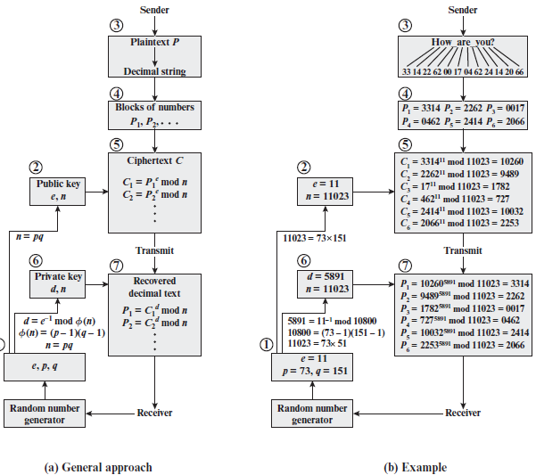
RSA Example

Slide 35
RSA Application
Encryption/decryption: The sender encrypts a message with the recipient’s public key, and the recipient decrypts the message with the recipient’s private key.
Digital signature: The sender “signs” a message with its private key.
Key exchange: Two sides cooperate to exchange a session key.

